Slide 1


A Study of the 23 October 2022 Southern England Damaging MCS
Ken Pryor
NOAA/NESDIS/STAR
David Smart, TORRO/UCL Hazard Centre
Matthew Clark, UK Met Office
David Flack, UK Met Office
Sarah Horton, TORRO

Slide 2
Introduction
During the afternoon of 23 October 2022, a linear-type mesoscale convective system (MCS) developed and intensified over the English Channel, and tracked north-northeastward into southern England, producing tornadoes and widespread damaging straight-line (downburst) winds.
The most intense downburst-related winds of the event were recorded at:
Middle Wallop Airport, Hampshire (55 miles SW of London), with a wind gust of 54 kt (62 mph) recorded between 1500 and 1600 UTC and generated by a prominent bowing segment of the MCS.
London Colney, Hertfordshire, with a wind gust of 56 kt (64 mph) recorded at 1640 UTC and generated by a intense discrete embedded cell east of the bowing segment of the MCS.
Significant tornado events occurred over Hampshire between 1430 and 1530 UTC:
Barton on Sea to Hurstbourne Priors, >60 km-length track
Marwell, 3.75 km length track

Slide 3
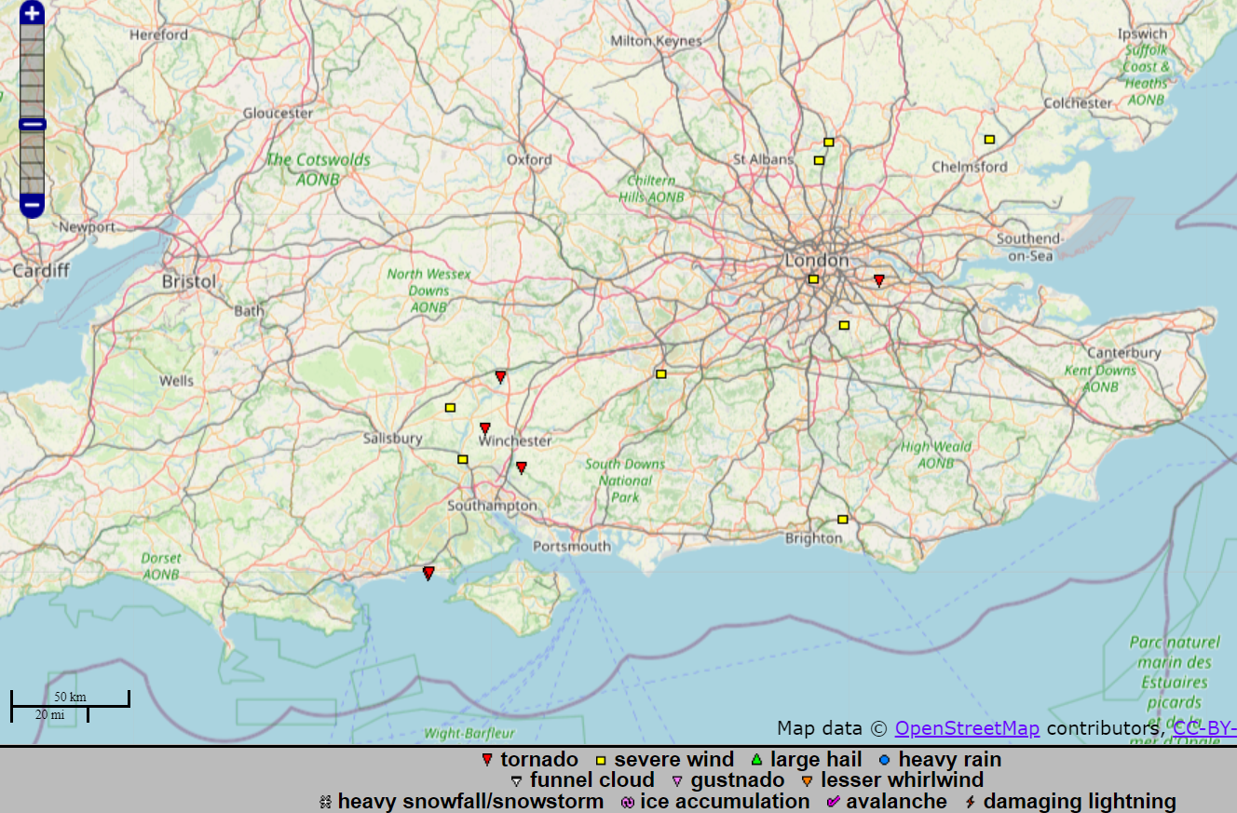
London and SE England Bow Echo
Dorset-Hampshire-Sussex
Bow Echo and Supercell

Slide 4
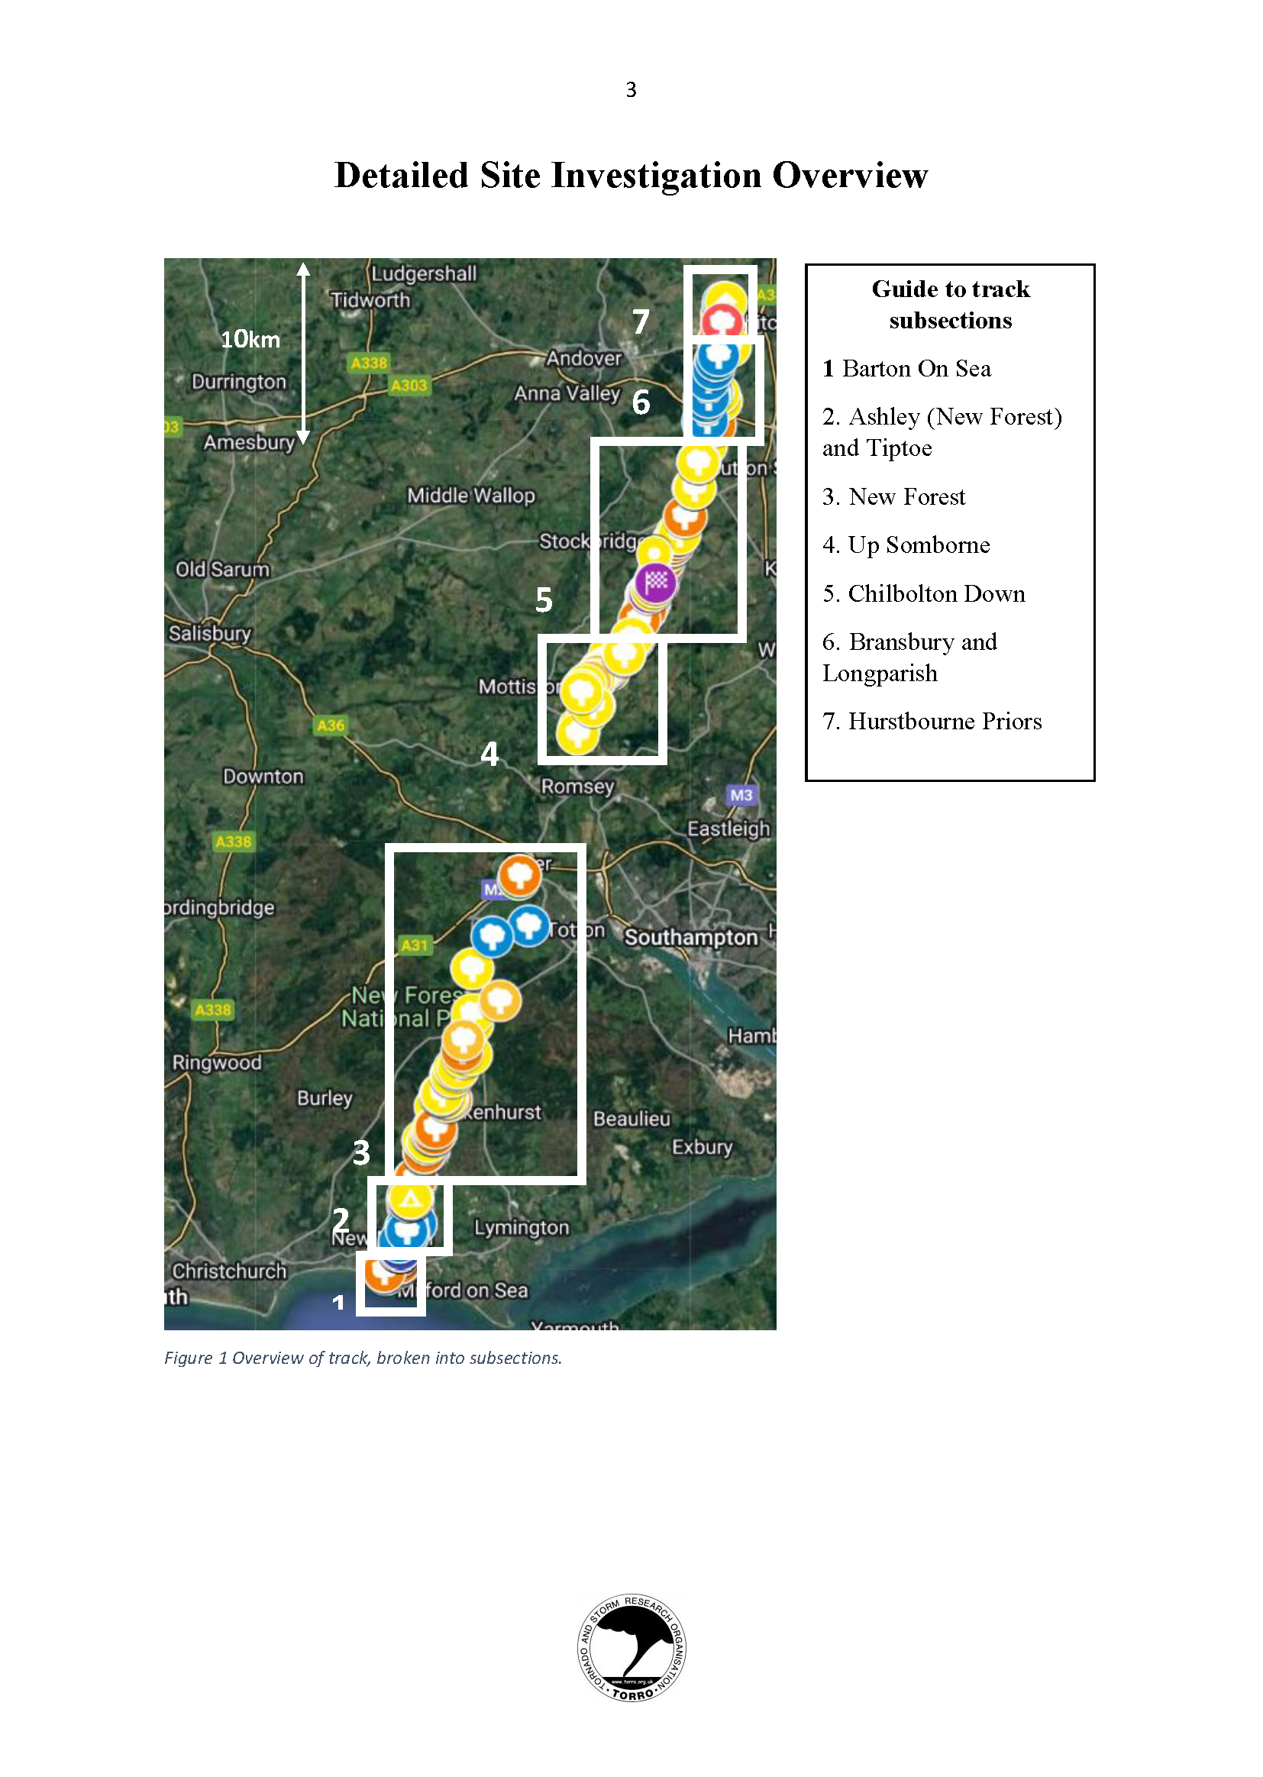
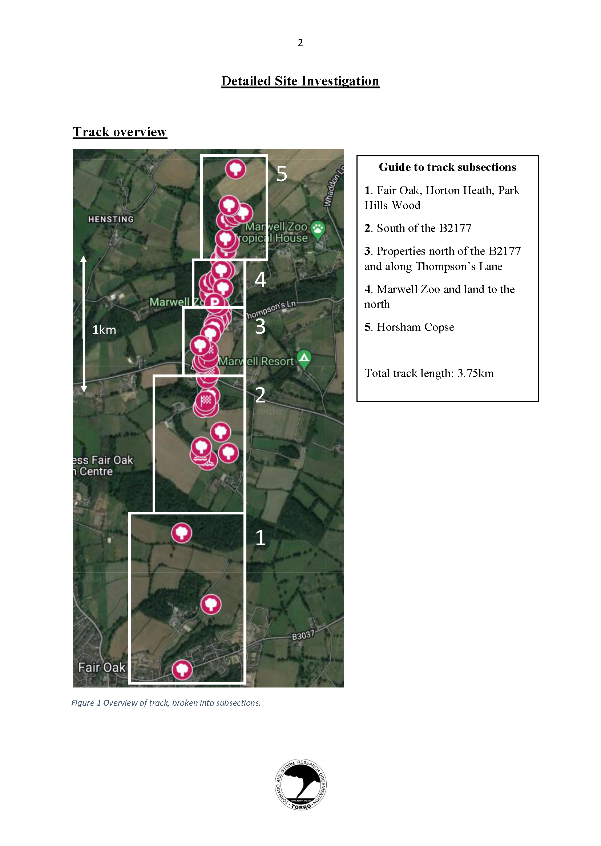
TORRO Site Investigation Reports Sarah Horton, Author
The Barton on Sea to Hurstbourne Priors Extended Tornado
track 23 October 2022. TORRO site Investigation
report: SI20221023_BOS_HP
The Marwell Tornado 23 October 2022.
TORRO site Investigation report: SI20221026_Marwell

Slide 5
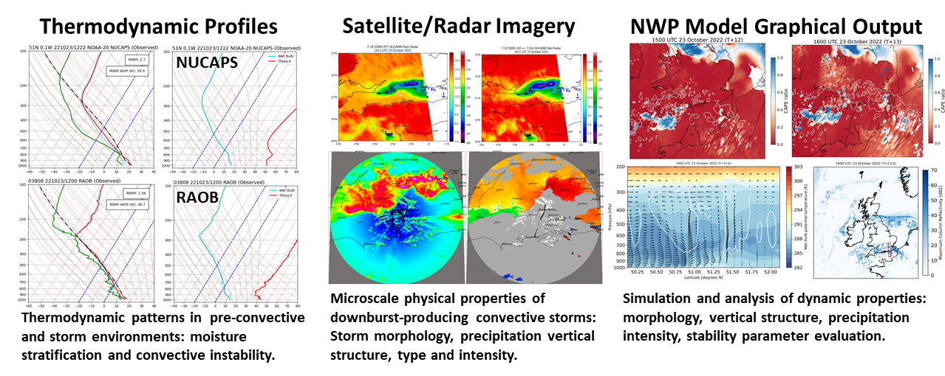
Data Analysis and Methodology
NUCAPS: NOAA-Unique Combined Atmospheric
Processing System is the NOAA enterprise
algorithm for retrieval of temperature and
moisture profiles and derived stability parameters.
Passive microwave (MW) observations from polar-orbiting satellites are instrumental in identifying convective storms with dense ice-phase precipitation cores that can generate intense downdrafts by the processes of loading, melting, and evaporation.

Slide 6
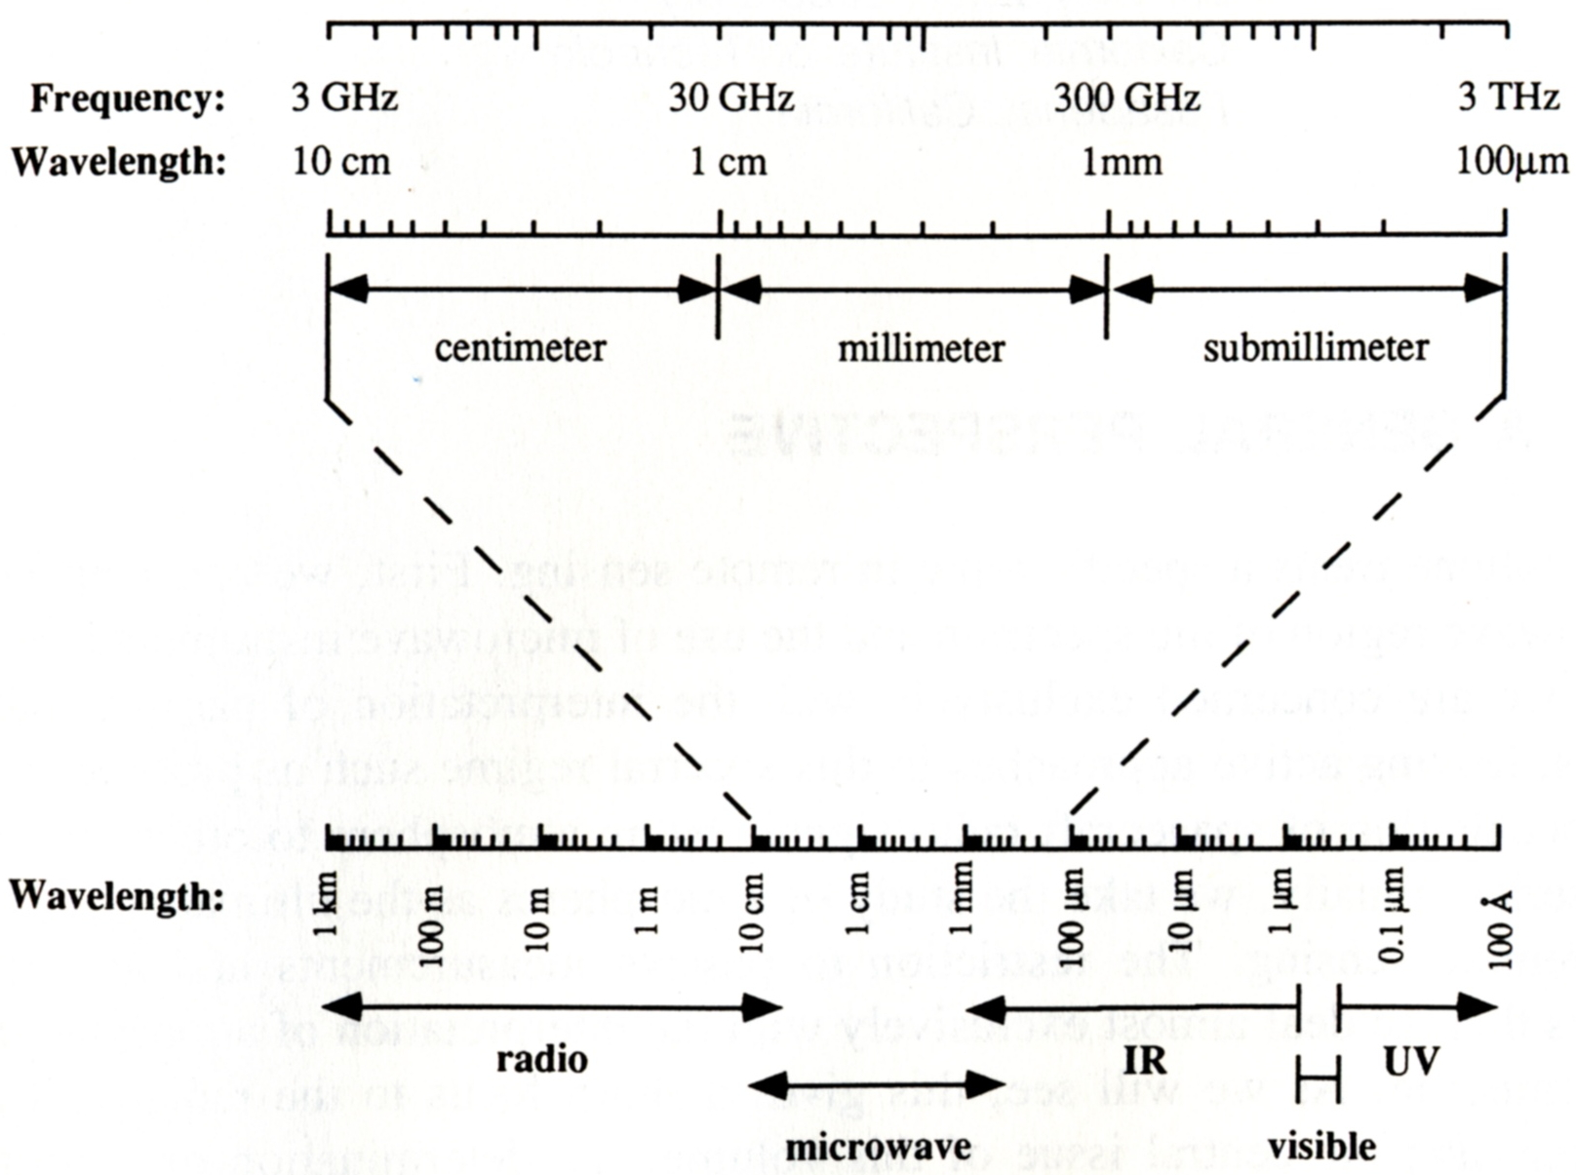
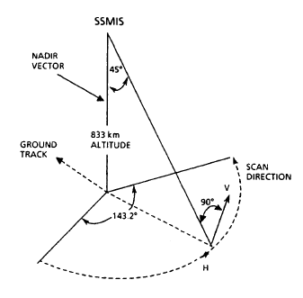
The microwave region
The microwave region generally spans the range from about 3 GHz to 300 GHz.
U.S. NEXRAD/
UKMO Doppler
Ground-based MWRP:
Radiometrics Corp MP-3000
Satellite MWR:
ATMS, AMSU-A, GMI, MHS,
SSMIS
Notes:
The microwave region generally spans the range from about 3 GHz to 300 GHz and above, although there is no wide acceptance of an exact range, or in particular, of an upper frequency limit.

Slide 7
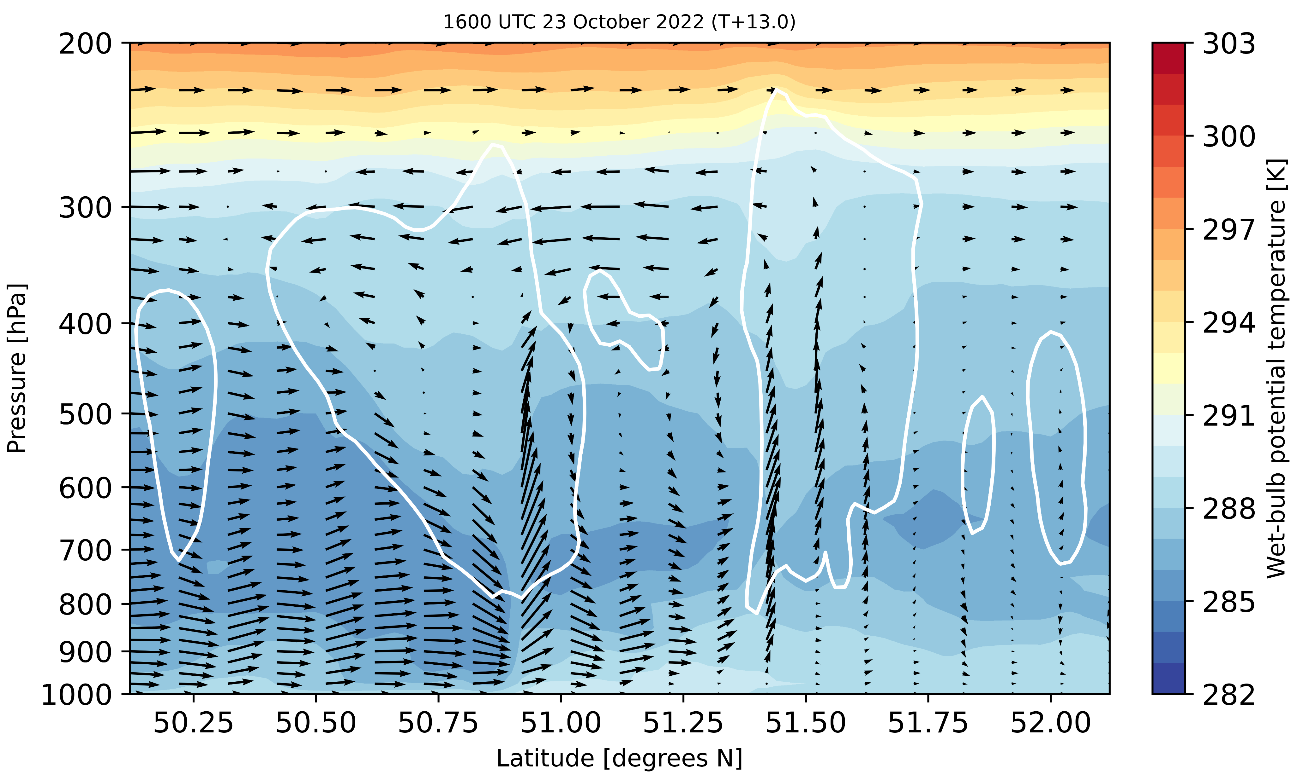
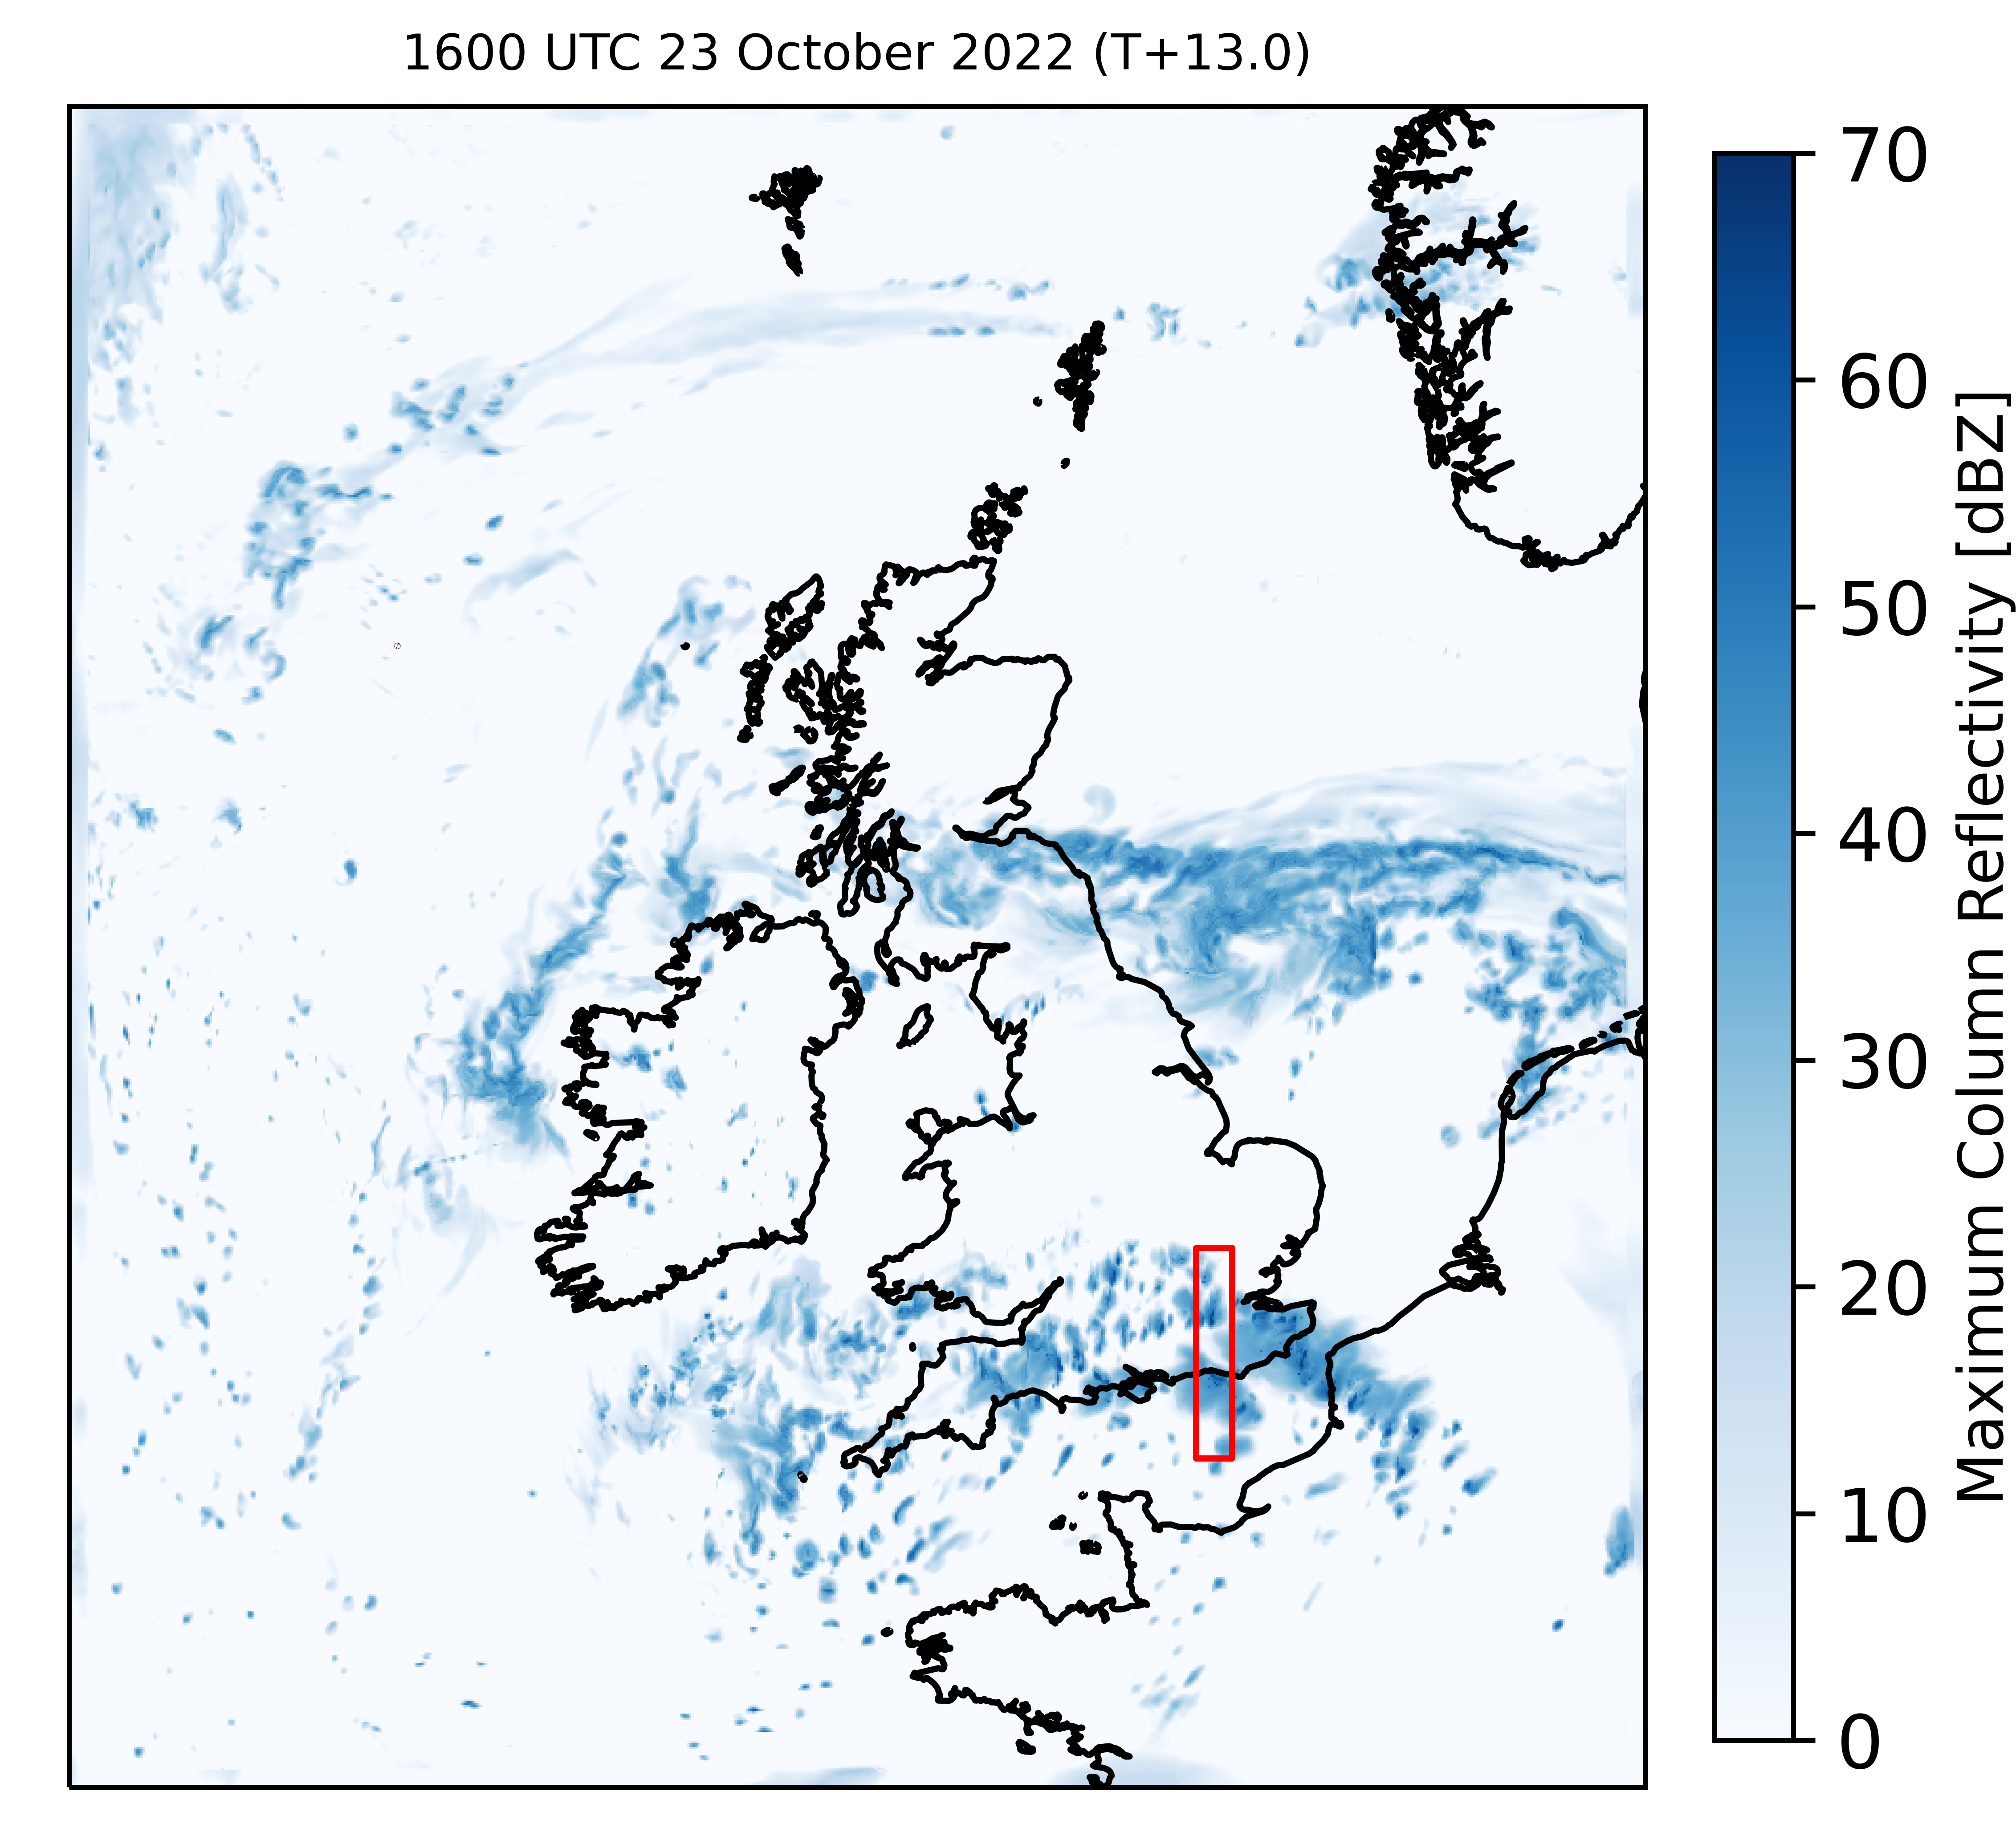
MOGREPS-UK Model Simulation
a)
b)
Strong rear-flank mid-level flow, with low theta-w values, into the MCS; large potential instability downstream of the MCS.
MOGREPS-UK: Met Office Global and Regional Ensemble Prediction System
Courtesy Dr. David Flack, Met Office

